Slide 1
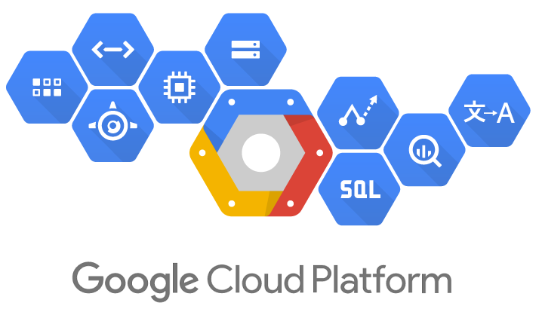
DATA TRANSFORMATION IN THE CLOUD
By,
Inchara S
4VV22IS041

Slide 2
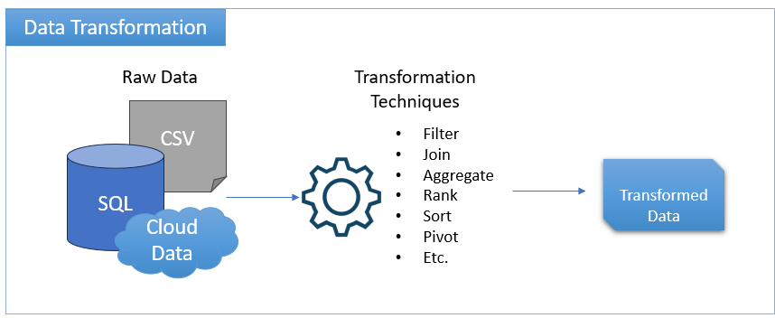
What Is Data Transformation?
Data transformation, at its core, is the process of systematically reshaping, cleaning, and enriching data. It readies data for analysis, reporting, or integration into other systems. In short, it is the process of converting data from one format to another.

Slide 3
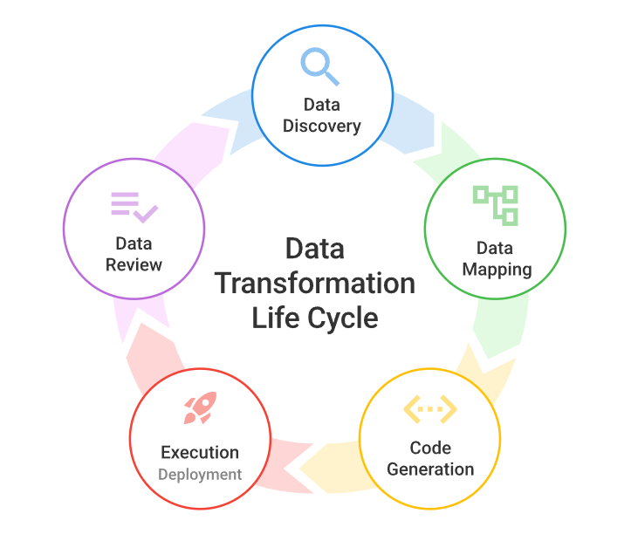
Data Transformation Life Cycle

Slide 4

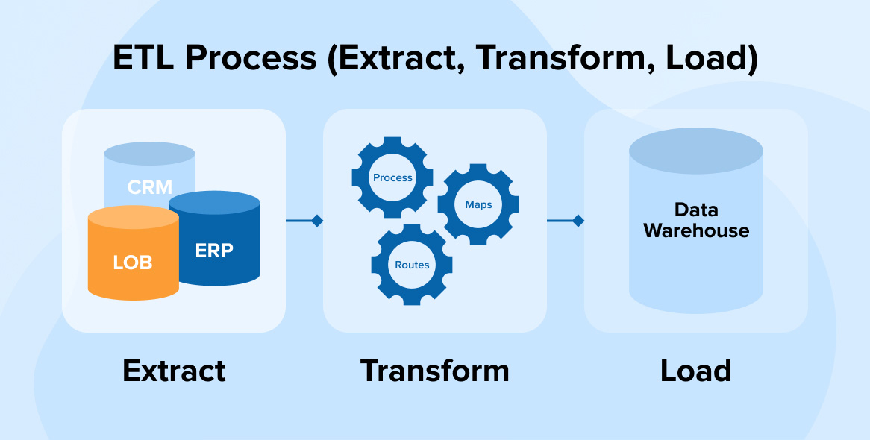
Data Pipeline Process
The purpose of a data pipeline is to automate data collection, transformation, and storage for
businesses. The data pipeline begins when data is collected in the collection phase of the data
journey. The data pipeline moves collected data to where it’s stored for future analysis in the
storage phase.
There are three processes of a data pipeline, including extract, transform, and
load. These data pipeline processes are also known as the E-T-L process.

Slide 5

Data Aggregation
Data aggregation is the process of collecting and summarizing data from various sources into a single, consolidated format for analysis and reporting. This process helps in gaining a comprehensive view of the data, identifying trends, and making informed decisions.
Benefits of Data Aggregation
Improved decision-making: Aggregated data provides a holistic view of information, enabling better-informed decisions based on trends and patterns.
Efficiency and cost savings: By consolidating data from various sources, businesses can avoid redundant efforts and save resources.
Enhanced reporting and analysis: Summarized data makes it easier to generate reports, identify key performance indicators (KPIs), and perform in-depth analysis.
Data-driven insights: Aggregation reveals hidden patterns and relationships within the data that may not be apparent when looking at individual data points.

Slide 6
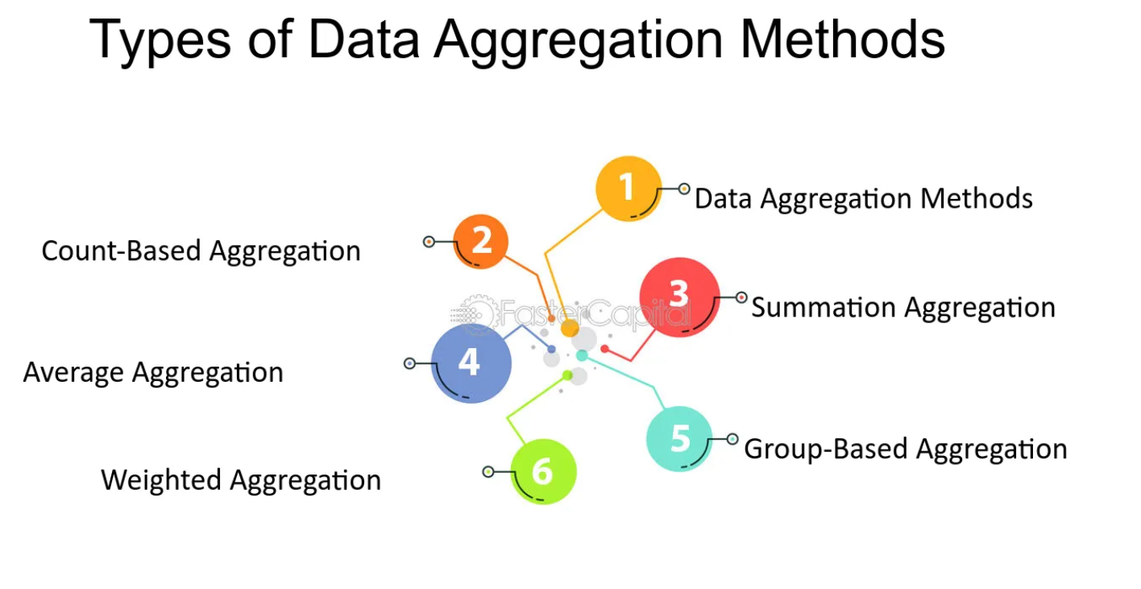

Slide 7
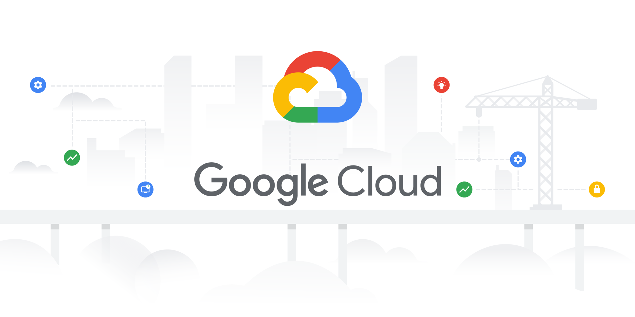
Thank You :)

